Slide 1
Gaussian Processes

Slide 2
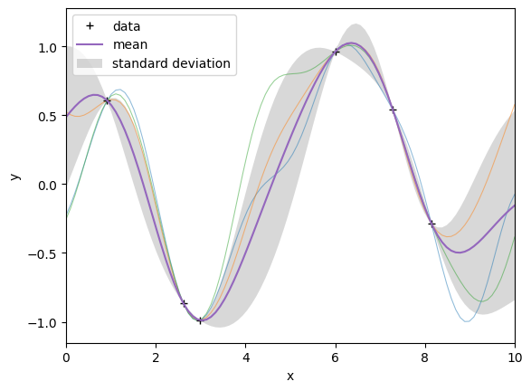
Motivation
General method of statistical interpolation
Can be applied within any discipline to sampled data that satisfy the appropriate mathematical assumptions.
Can be used where spatially related data has been collected (in 2-D or 3-D)
Applicable fields include: environmental science, hydrogeology, mining, remote sensing, real estate appraisal, astronomy

Slide 3
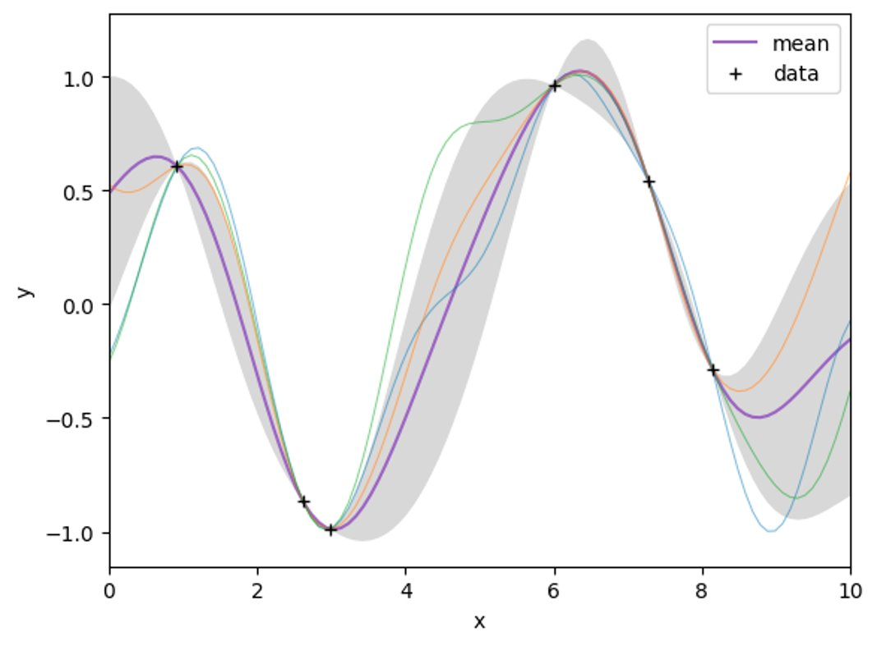
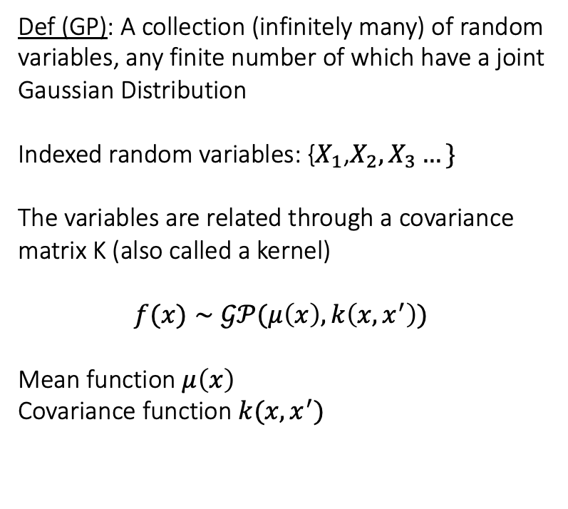
Definition
Def (GP): A collection (infinitely many) of random variables, any finite number of which have a joint Gaussian Distribution
Indexed random variables: {$X_{1}\text{,}X_{2}{,X}_{3}…\}$
The variables are related through a covariance matrix K (also called a kernel)
$$f(x)∼𝒢𝒫(μ\left(x\right),k\left(x,x^{′}\right))$$
Mean function $μ\left(x\right)$
Covariance function $k(x,x^{′})$

Slide 4
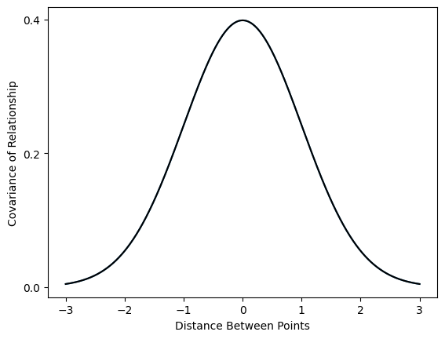
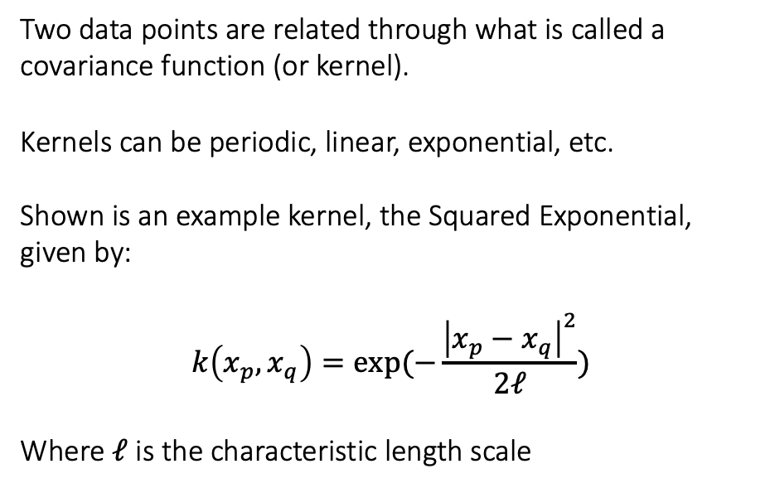
Covariance Function
Two data points are related through what is called a covariance function (or kernel).
Kernels can be periodic, linear, exponential, etc.
Shown is an example kernel, the Squared Exponential, given by:
$$k\left(x_{p},x_{q}\right)=exp(−\frac{{\left|x_{p}−x_{q}\right|}^{2}}{2ℓ})$$
Where $ℓ$ is the characteristic length scale

Slide 5
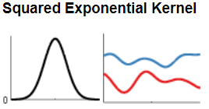
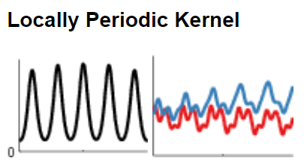
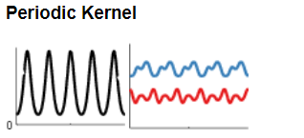
Changing Covariance Functions
Reasoning
Some common covariance functions include
Squared Exponential,
Periodic, and
Linear
However, we can create complicated kernels through adding/multiplying kernels together or altering its parameters.

Slide 6
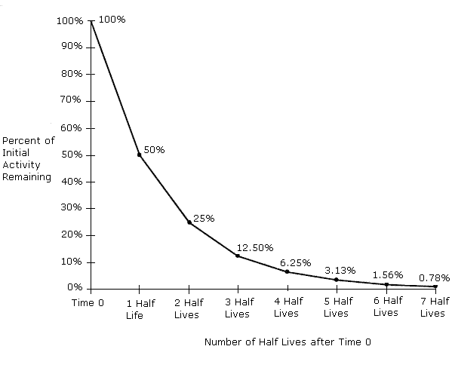
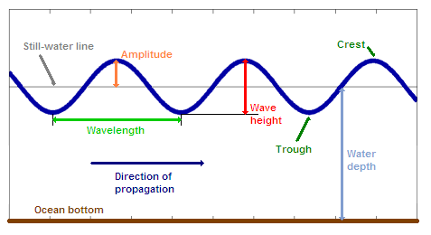
Illustration by example
Radioactive Decay
Waves
Notes:
Consider the following data models of Coastal Wave Data of a Buoy and Radioactive Decay of an element.
Both are real-world phenomenon that exhibit drastically different behaviors with respect to time.
Ideally, we’d like to find the simplest possible covariance function so that our model is not only accurate to our dataset but for all similar behaviors.

